Slide 1
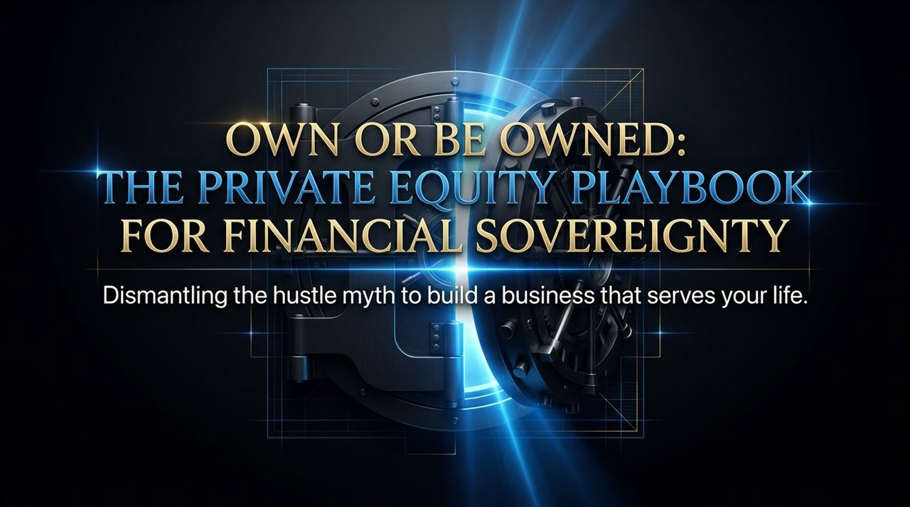
Notes:
Welcome everyone. Today, we’re unpacking a concept that completely flips traditional entrepreneurship on its head: moving from being owned by your business to actually owning an asset that serves your life.
Most business advice online pushes what Codie Sanchez calls hustle culture or trauma-bonding—the idea that you must grind yourself to exhaustion until you eventually outlive the competition.
But as Codie highlights in her discussion with Lewis Howes, working yourself into burnout isn't a badge of honor; it’s a design flaw in your business model.
Over the next 16 slides, we are going to walk through the exact Private Equity framework designed to dismantle this hustle myth and build true financial sovereignty through systematic ownership.
The Deepest Conversation You’ll Ever Watch About Money | Codie Sanchez
https://www.youtube.com/watch?v=a_5-iAEMRpE

Slide 2
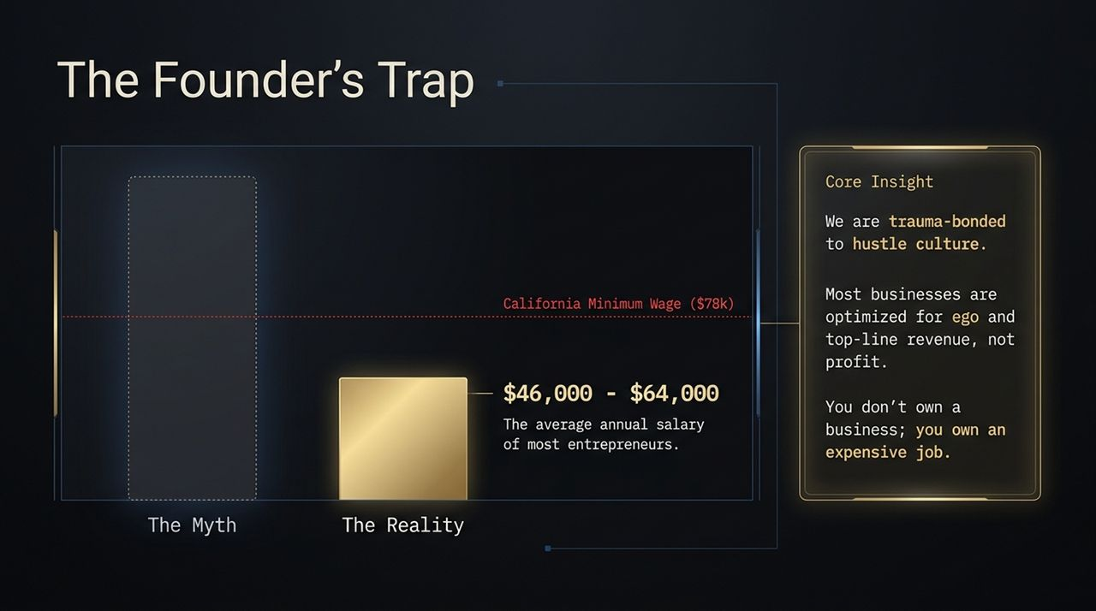
Notes:
Let's address The Myth vs. The Reality. The popular myth glorified on social media shows founders flying on private jets and making millions while barely working.
The Reality? The average annual salary of most entrepreneurs across the U.S. is just $46,000 to $64,000. To put that in perspective, California’s minimum wage equates to roughly $78,000 per year. That means the majority of business owners make less than minimum wage when accounting for their time.
Core Insights:
Trauma-Bonding to Hustle: We’ve been conditioned to believe that if business isn't miserable and hard, we aren't trying hard enough.
Ego vs. Profit: Most founders optimize for top-line revenue because big figures sound impressive, but revenue is a vanity metric if net income is zero.
The Trap: If you stop working and cash stops flowing, you don't own a business; you own an expensive, stressful job.

Slide 3
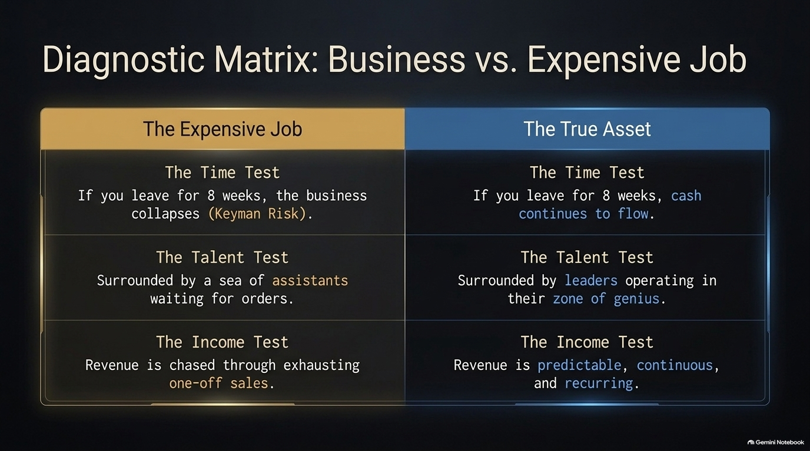
Notes:
To determine whether you own a true business asset or just an expensive job, you must run your company through three core diagnostic tests:
1. The Time Test:
Expensive Job: If you take off for 8 weeks, does the company collapse? This is classic Keyman Risk—where you are the sole key that unlocks the value.
True Asset: If you step away for 8 weeks, systems and processes ensure that cash continues to flow seamlessly without your daily intervention.
2. The Talent Test:
Expensive Job: You are surrounded by a sea of assistants who wait around for your orders because you're afraid to hire people smarter than you.
True Asset: You are surrounded by leaders operating directly in their zone of genius, executing higher-level decisions independently.
3. The Income Test:
Expensive Job: Revenue is continuously chased through exhausting, one-off sales cycles.
True Asset: Revenue is predictable, continuous, and automated via recurring models.

Slide 4
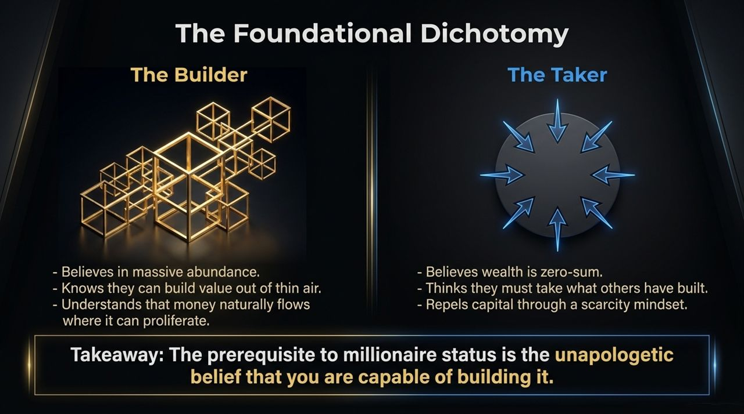
Notes:
Financial sovereignty starts with identity and mindset. In the interview, Codie notes that people generally split into two categories: The Builder vs. The Taker.
The Builder:
Operates from a belief of massive abundance.
Knows they can create value out of thin air by solving real market problems.
Understands that capital naturally flows and multiplies where it can proliferate—like a growing garden.
The Taker:
Believes wealth is zero-sum—that for them to win, someone else must lose.
Operates from scarcity, attempting to extract value rather than construct it.
Key Takeaway: The prerequisite to building real wealth is shifting from a scarcity mindset to the unapologetic belief that you are capable of building long-term value.

Slide 5
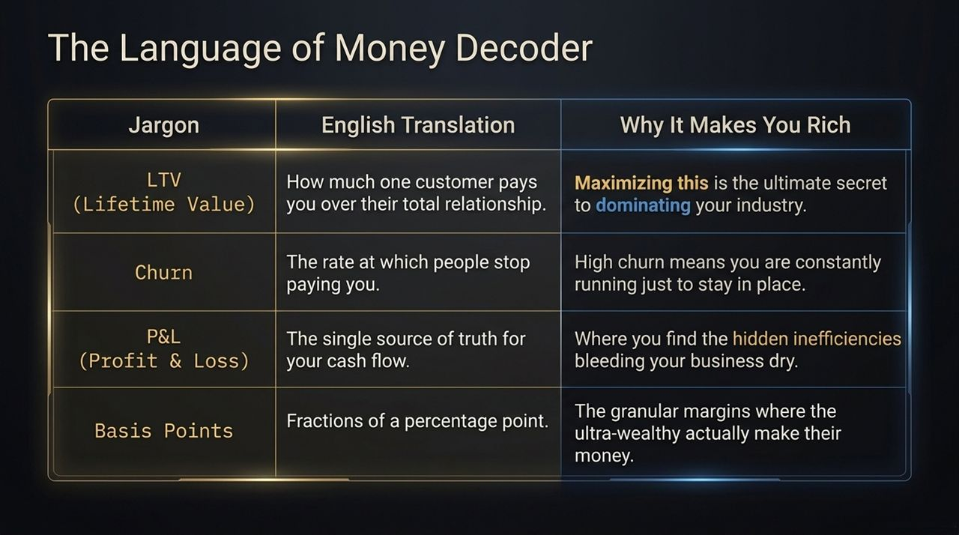
Notes:
Why do private equity firms consistently acquire businesses and dramatically scale their profitability? They don't rely on creative genius; they run a repeatable playbook.
The 4-Step Private Equity Framework:
Diagnose: Start at the single source of truth—the Profit & Loss (P&L) statement—to locate hidden inefficiencies and cost leaks.
Score: Audit the business against the 12 Core Profit Levers (The 12 Ps) using structured scoring metrics.
Strategy: Implement system fixes, optimize terms, raise prices, and transition to recurring structures.
Review: Enforce a strict 90-day review cadence to eliminate operational blind spots and measure progress.
As David Adelman and other PE leaders state: Don't try to be a genius. Just steal the homework and run the playbook.

Slide 6
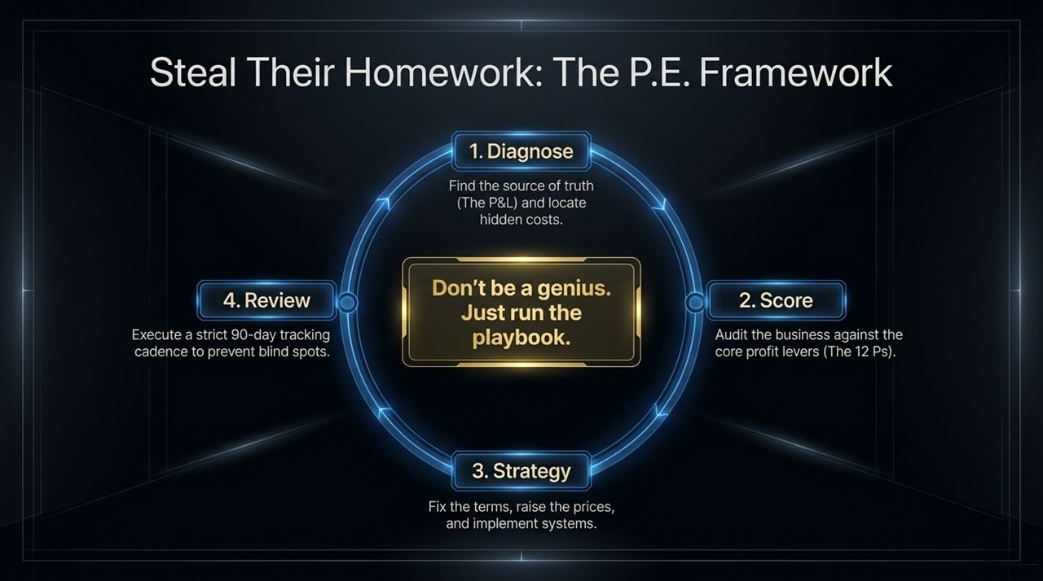
Notes:
The Source of Truth: Your P&L statement is the single most honest document in your organization.
Before wasting effort trying to acquire more customers or drive top-line growth, run a thorough X-ray on your costs.
Why starting with costs matters:
It is significantly easier to keep the money you already make than to double your sales volume.
Pouring more marketing dollars into a business with poor operational efficiency is like pouring water into a leaky bucket.
Action Step: Audit your operating expenses, hidden subscription fees, and structural inefficiencies today.

Slide 7
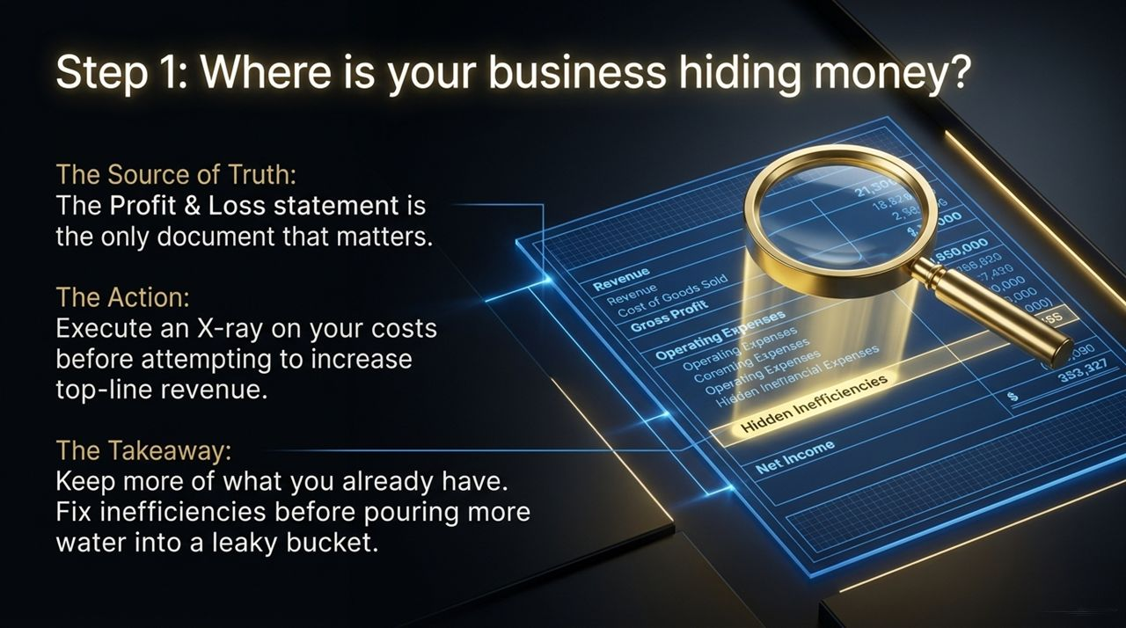
Notes:
When looking to optimize revenue and cash flow, there are 3 immediate levers every business owner should pull:
Lever 1: Persona (Who)
Stop projecting your personal wallet onto your clients. Many owners underprice because they wouldn't buy at high rates. Target high-capital clients who value time and outcome over price.
Lever 2: Pricing (How Much)
Transition from market-based pricing (matching competitors) to value-based pricing. Most small businesses are underpriced by 30% to 300%. Adjust payment terms to collect cash upfront.
Lever 3: Recurring Lifetime Value (LTV) (How Often)
Shift away from one-off transactional sales. Build continuous billing structures where customers pay automatically month after month.

Slide 8
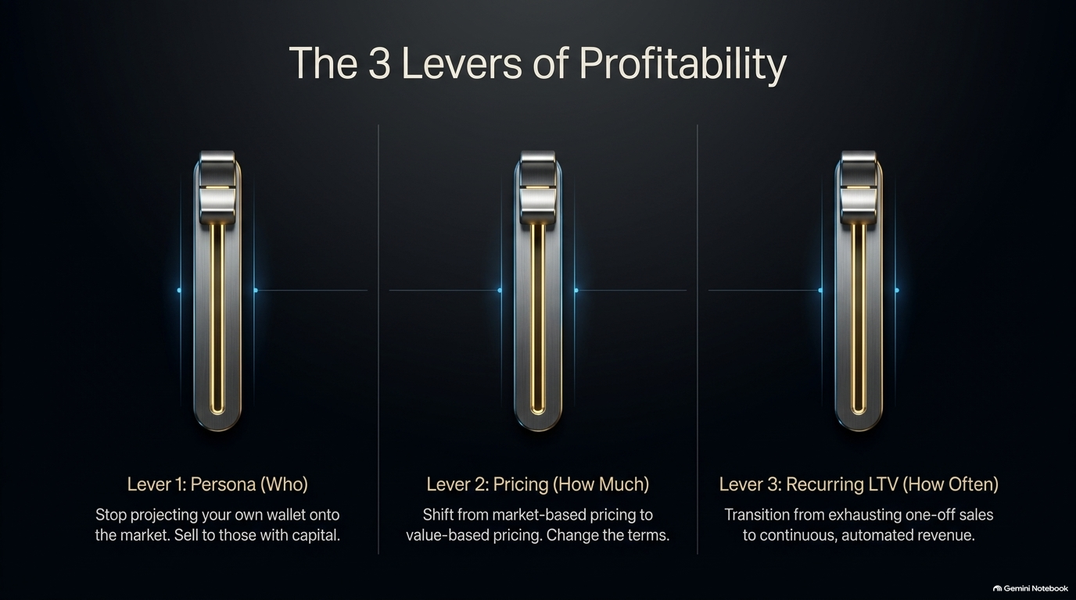
Notes:
Private Equity frameworks evaluate business operations across 12 distinct P levers to generate an overall Owner Score.
While all 12 levers contribute to total business health, 7 core levers drive immediate cash flow improvements:
Persona: Aligning with affluent, high-LTV targets.
Pricing: Moving away from cost-plus to value-driven positioning.
Product: Packaging offerings for scale rather than customized labor.
Profit: Ensuring cash flows to the owner first rather than last.
Process: Documenting SOPs so execution doesn't depend on key talent.
People: Aligning incentives and hiring leaders rather than task-doers.
Promotion/Pipeline: Establishing predictable customer acquisition systems.

Slide 9
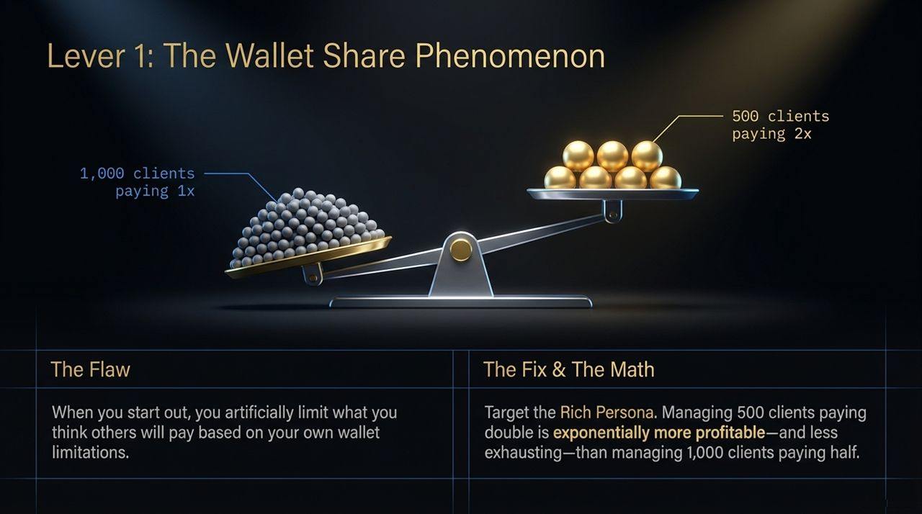
Notes:
To build a business that runs without you, you must understand your own operational blind spots. Codie identifies 12 Founder Archetypes in her book:
Common Archetype Profiles:
The Workhorse: Equates hard work with success; takes on all tasks instead of delegating or setting boundaries.
The Ball Hog: Wants to take every shot himself; acts like Michael Jordan without a coach or team.
The Good Guy: Reluctant to raise prices or enforce tough contract terms for fear of conflict.
The Dreamer / Founder: Attached to original ideas even when the market signals it's time to pivot.
Identifying your archetype is the first step toward stepping out of the day-to-day operations and building systems to balance your weaknesses.

Slide 10
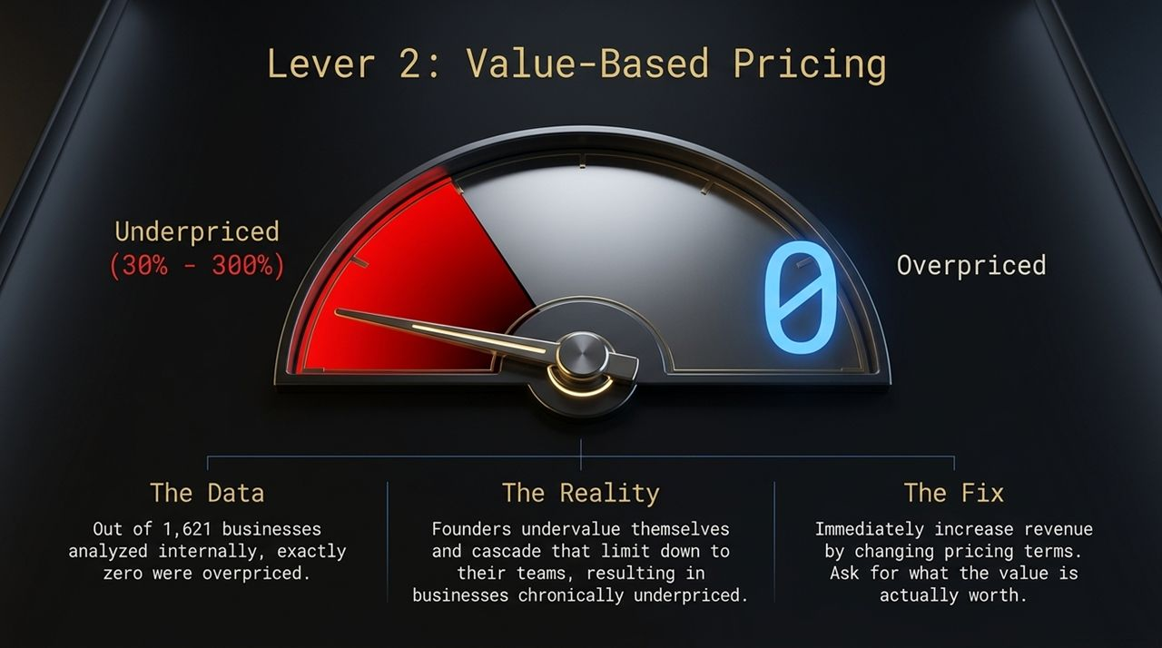
Notes:
You cannot manage what you do not measure. Calculating your Owner Score provides an objective audit of your business asset health.
How the Audit Works:
Evaluate your performance across the 12 Profit Levers.
Determine your level of Keyman Risk (how dependent the business is on your daily involvement).
Identify whether your income is recurring or transactional.
Goal: A low Owner Score indicates an expensive job; a high Owner Score reflects an independent, scalable asset ready for growth or exit.

Slide 11
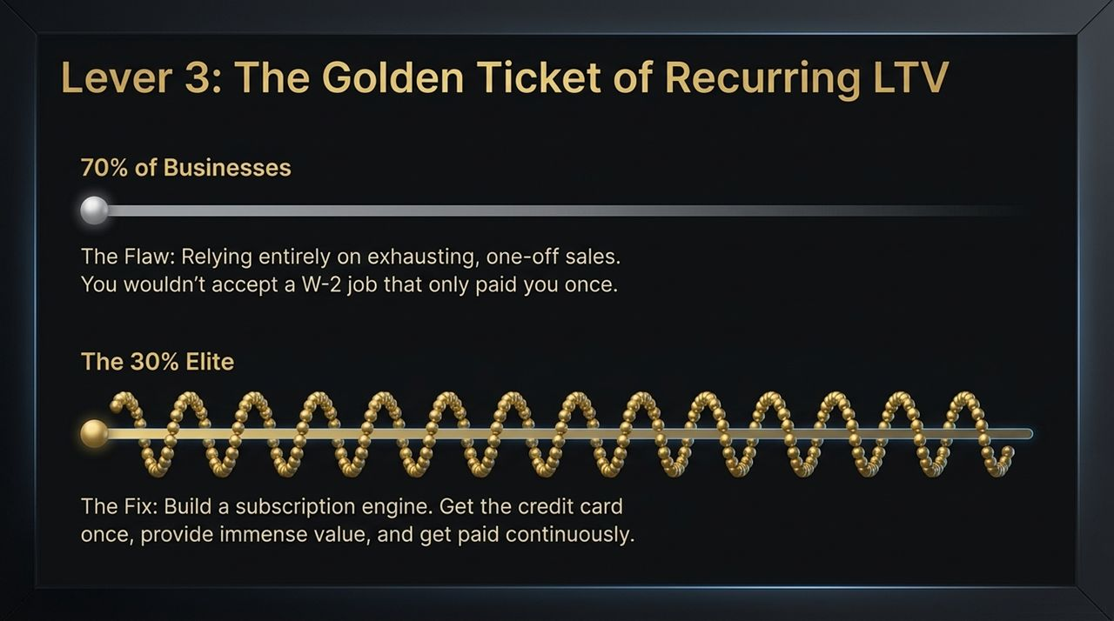
Notes:
Once you've scored your business, it’s time to execute strategic operational upgrades:
1. Value-Based Pricing: Re-evaluate your contracts. Raising prices by even 10–20% without increasing overhead directly expands net profit margins.
2. Automated Recurring Revenue: Convert one-time service deals into retainer, membership, or subscription structures.
3. Operational SOPs: Systematize core workflows so team members can execute tasks seamlessly without requiring owner approval.
4. Incentive Alignment: Align employee compensation with profit goals so leadership acts like owners.

Slide 12
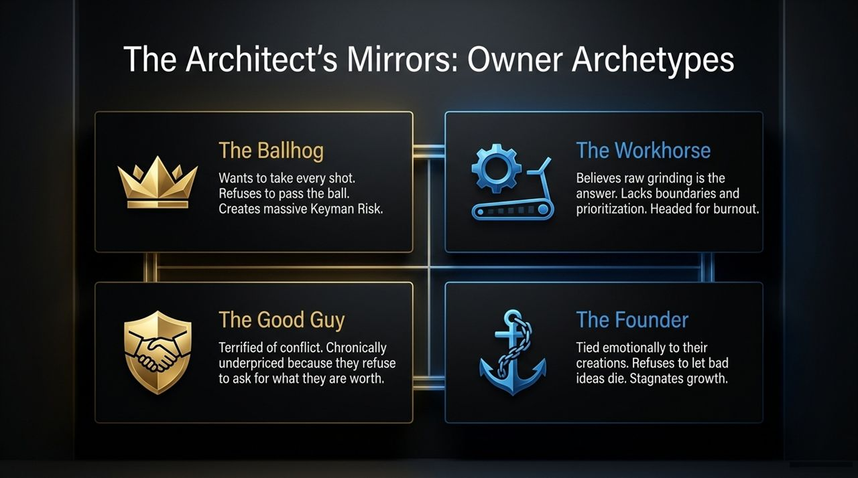
Notes:
Growth isn't a one-time event; it’s a discipline. Implementing a strict 90-day review cycle keeps your business on track.
Quarterly Review Checklist:
Audit P&L statements for margin compression and rising costs.
Review KPI scorecards for key department leaders.
Track customer LTV and churn rates.
Re-assess Keyman Risk across all operational departments.
Consistent 90-day sprints prevent operational drift and keep the business optimized for cash flow.

Slide 13
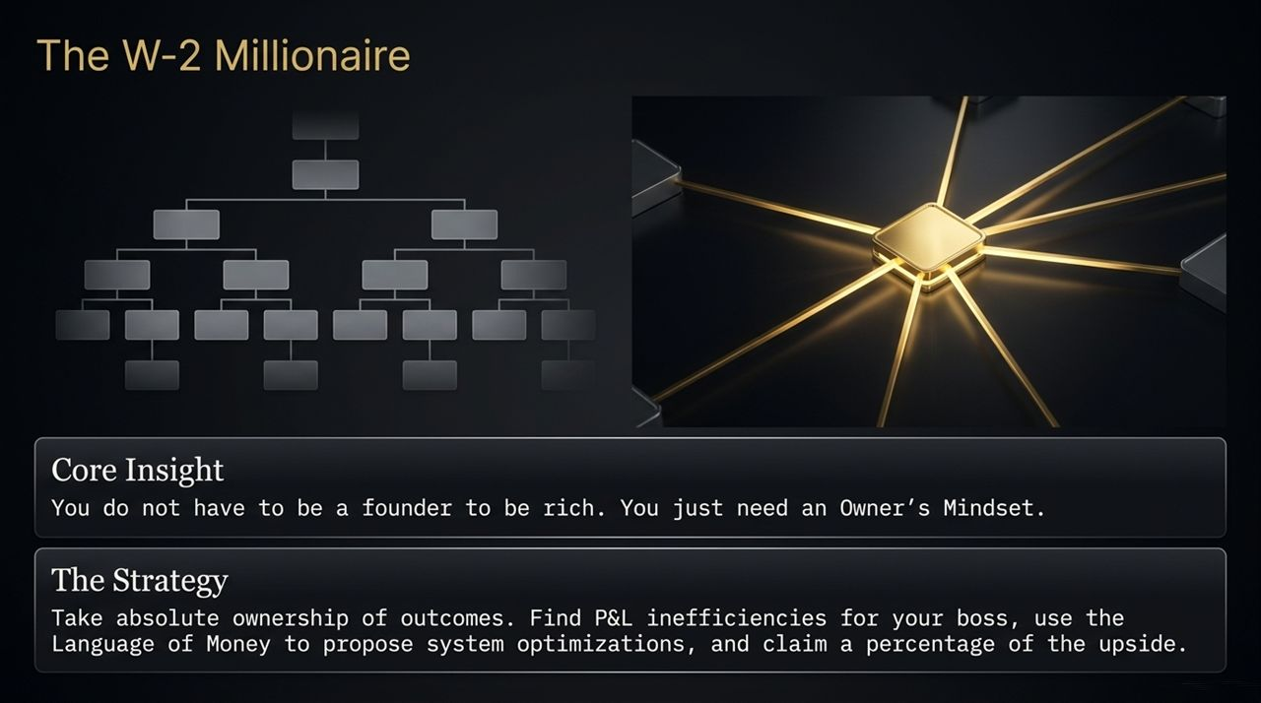
Notes:
Let's look at a practical transformation case study:
Before (Keyman Trap):
Owner works 60+ hours a week.
Revenue relies on one-off sales calls made personally by the founder.
Margins are tight due to low prices and unmanaged operational expenses.
After (P.E. Playbook Applied):
Prices restructured using value-based models (+30% margin increase).
Recurring retainers implemented, securing predictable monthly cash flow.
SOPs and leadership delegation reduce owner work hours to strategic oversight.

Slide 14
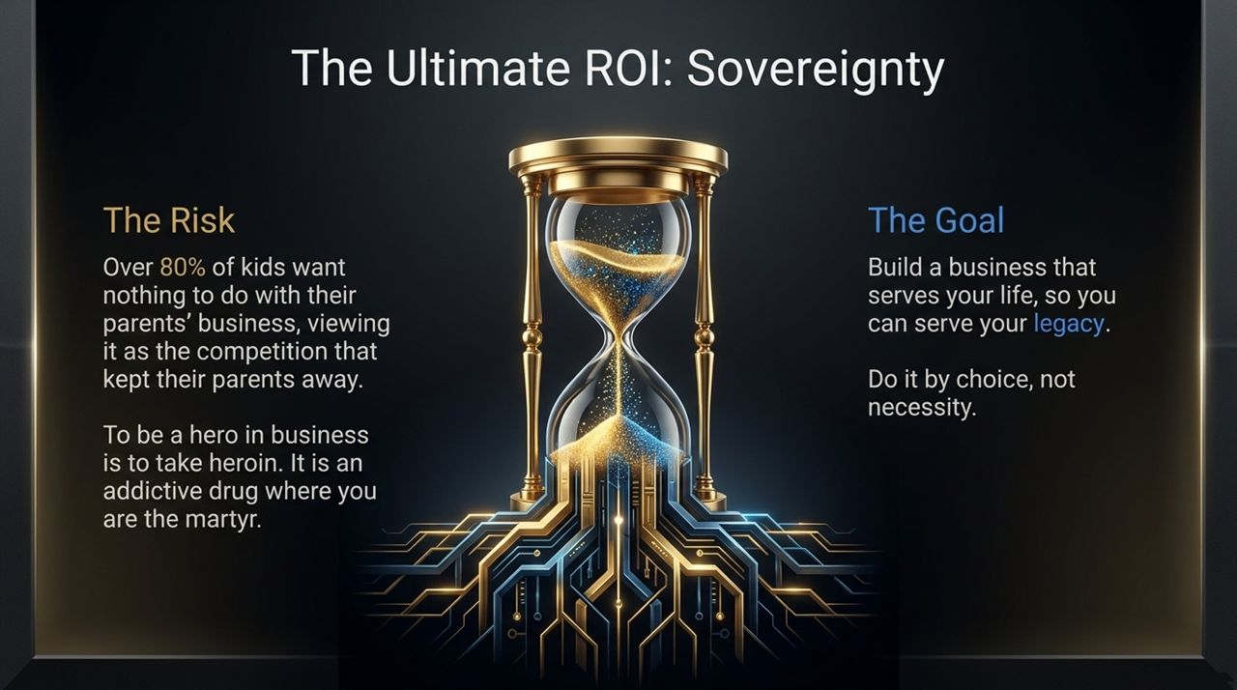
Notes:
To build true financial sovereignty, you must speak the language of money.
Wealthy operators and investors communicate using specific financial metrics:
LTV (Lifetime Value): The total revenue a single customer generates over their lifetime.
CAC (Customer Acquisition Cost): The total cost required to acquire a new paying client.
Churn Rate: The percentage of recurring customers who cancel their services over a given period.
EBITDA: Earnings Before Interest, Taxes, Depreciation, and Amortization—the ultimate baseline metric for business valuation.
Mastering these concepts allows you to make data-driven decisions rather than emotional ones.

Slide 15
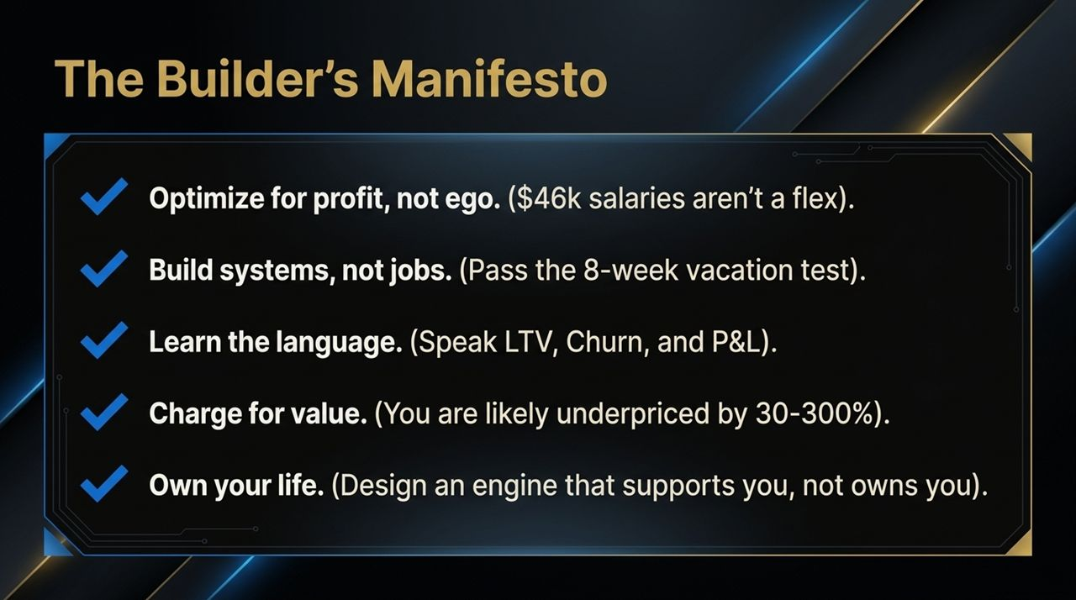
Notes:
The ultimate goal of financial sovereignty is time freedom.
As Codie points out, business should fit into a life you enjoy, rather than forcing your life to fit around an exhausting business schedule.
Key Takeaway: Stop acting like a martyr or hero in your company. Build systems, empower leaders, and leverage proven playbooks so your business serves your personal life, family, and long-term sovereignty.

Slide 16
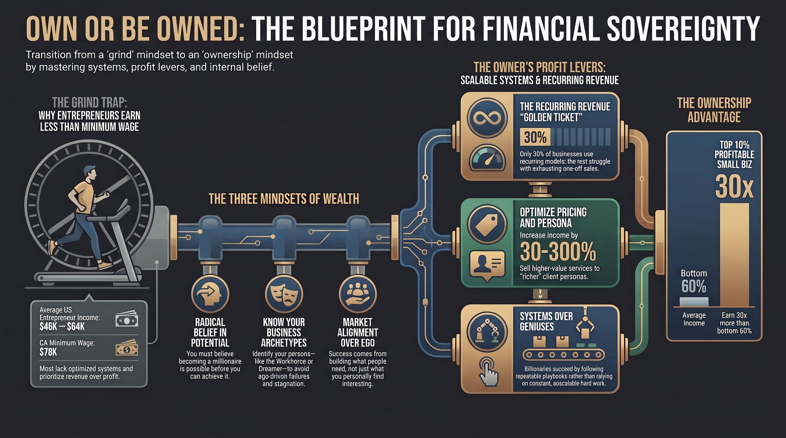
Notes:
Action Plan:
Perform a complete X-ray audit on your current P&L statement.
Take the Owner Score assessment at ownerscore.com to identify your business weaknesses and founder archetype.
Shift your pricing to value-based models and integrate recurring revenue mechanisms.
Implement 90-day review cycles to continuously optimize cash flow.
Thank you! Let's open the floor to questions and begin building businesses that truly serve our lives.
The Deepest Conversation You’ll Ever Watch About Money | Codie Sanchez
https://www.youtube.com/watch?v=a_5-iAEMRpE

